Slide 1
RET Project 4: Understanding the Spatiotemporal Variability of Air Pollution (PM_{2.5} & BC) in Microenvironments
Molly Hamilton, 10-12th grade math, School for Creative & Performing Arts
Kat Roedig, 11-12th grade science, The Summit Country Day School
Dr. Sivaraman Balachandran, PhD, PE
Farzan Oroumiyeh, GRA
Vincent Vutai, GRA
Dexter Adams, Intern
NSF Grant # EEC-1404766 “Challenge-Based Learning and Engineering Design Process Enhanced Research Experiences for Middle and High School In-Service Teachers”

Slide 2
Table of Contents
Abstract
Introduction
Background literature
Goals and objectives
Research methods & results
Research conclusions
Units

Slide 3
Abstract
Problem Statement
PM_{2.5} has a significant association with human health but has significant spatial variability
Portable air pollution monitors can help understand spatial variability
Project Objectives
Evaluate portable monitors versus regulatory monitors
Use portable monitors to measure air pollution in different microenvironments
Process and analyze data using standard statistical methods
Results
PM_{2.5} has significant variability in different microenvironments
Highest short-term concentrations
Holidays → July 4th
Highway with open windows
Walking adjacent to trucks

Slide 4
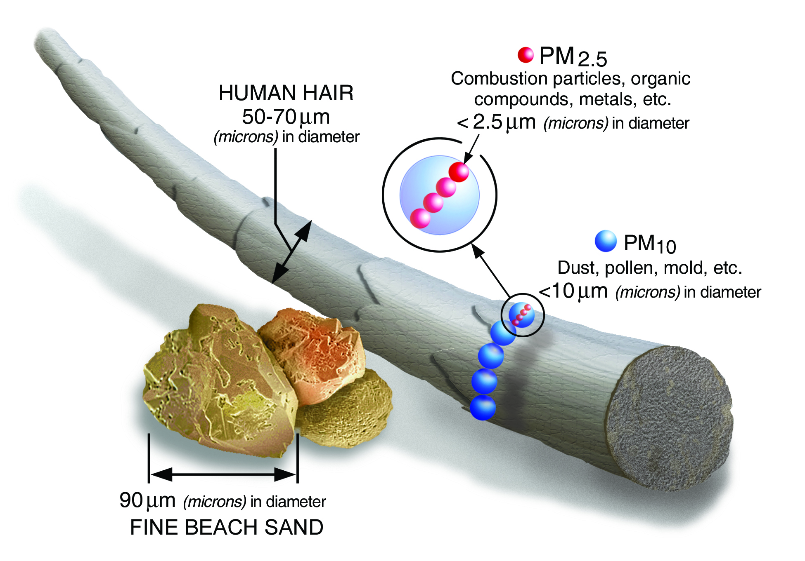
Introduction
Monitor air quality
6 criteria air pollutants
Ozone
Particulate matter
Carbon monoxide
Lead
Sulfur dioxide
Nitrogen dioxide
Figure 1: Visual of Size of PM
https://www.epa.gov/sites/production/files/2016-09/pm2.5_scale_graphic-color_2.jpg
Notes:
How many of you like to know that the air you are breathing is clean/safe to breathe?
Clean Air Act sets National Ambient Air Quality Standards for 6 criteria air pollutants that are defined by the EPA because of their health impacts
Our research focuses specifically on PM2.5 and an important constituent of PM2.5, BC

Slide 5
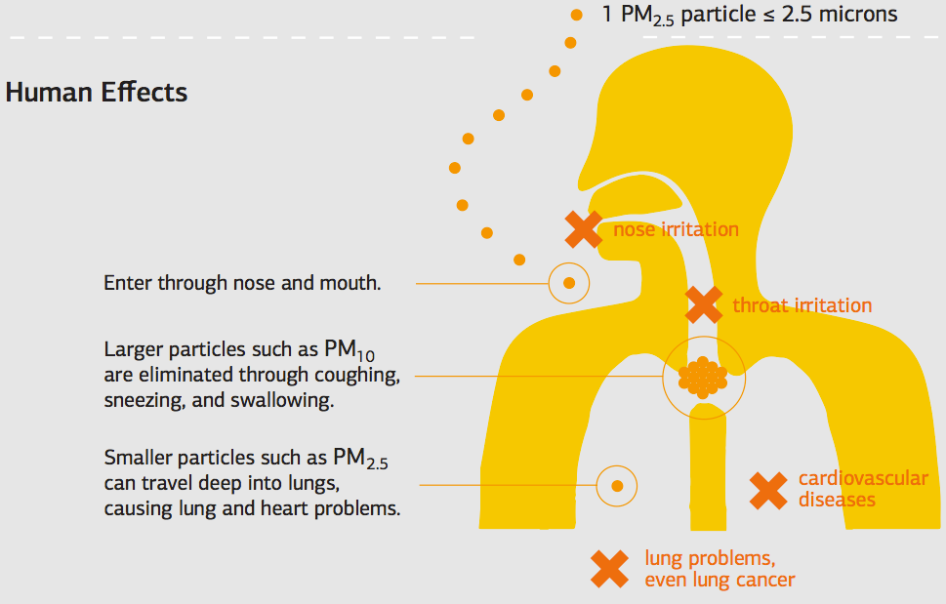
Figure 2 : Health Effects of PM_{2.5}
Human Effects
Enter through nose and mouth.
Larger particles such as PM₁₀ are eliminated through coughing, sneezing, and swallowing.
Smaller particles such as PM_{2.5} can travel deep into lungs, causing lung and heart problems.
http://www.environment-assured.com/wp-content/uploads/Screen-Shot-2015-05-08-at-14.56.37.png
Notes:
PM10 filtered out through respiratory passageways (cilia, mucous membranes, hair)--10 microns across--irritates human airways (asthma, dry itchy eyes and throat)
PM2.5 small enough to pass through the filtering aspects of respiratory system and can infiltrate deep into the lungs and infiltrate bloodstream (alveoli--where oxygen/carbon dioxide loading and unloading happens)
The PM2.5 stays in your lungs and builds up over time
Associated with both cardiovascular and respiratory health outcomes

Slide 6
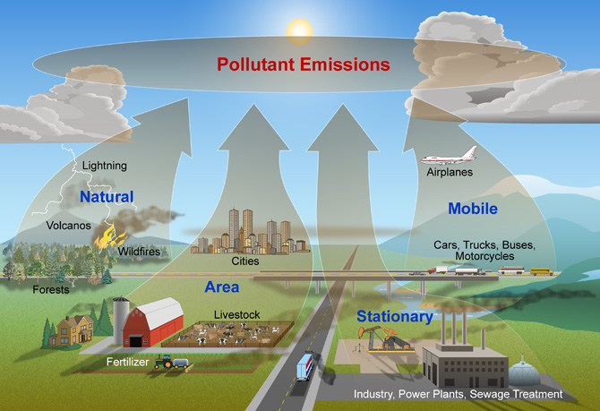
Figure 3: Contributors to Air Pollutants
https://www.nature.nps.gov/air/aqbasics/images/types_of_sources_02-2012.jpg
Notes:
How are these air pollutants created?
Anthropogenic (human caused)
Biogenic (natural causes)
All of these are major sources and go through transformations in the atmosphere--quantifying the impacts of all of these sources is a major topic in current air quality research

Slide 7
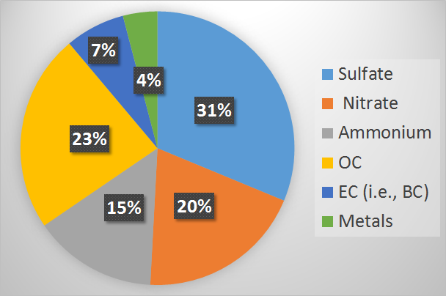
Figure 4: PM_{2.5} Speciation at Taft Site in Cincinnati, Ohio
Notes:
Specific components of PM2.5 in Cincinnati, Ohio
Sulfate and nitrate: mobile sources, power plants (fuel combustion)
Ammonium: agriculture
OC/BC: power plants, industry, mobile sources, biomass burning, meat cooking
Metals: mobile sources, industry, dust (crustal metals)
BC may seem small percentage but important because it has a positive global warming factor (meaning it contributes to it) and health impacts because of surface area to mass
BC much smaller than 2.5 (<.1)

Slide 8
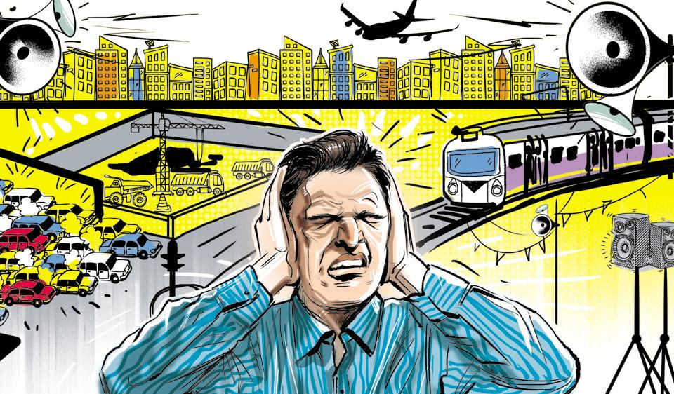
Introduction
Synergistic health effects
Noise pollution
Greater risk for CV problems (Beelen et al., 2008)
Figure 5: Noise Pollution Sources
http://www.hindustantimes.com/rf/image_size_960x540/HT/p2/2016/12/23/Pictures/_3d0c377a-c8c7-11e6-ad67-c7f41c1c9a76.jpg
Notes:
Synergistic health effects: greater risk when two factors combine (such as exposure to air and noise pollution)
Any annoying or distressing sound that interferes with sleep, daily activities or negatively affects one’s quality of life
Those affected by high air pollutants and high levels of noise(proximity to major roadways; traffic patterns)--greater risk for cardiovascular problems

Slide 9
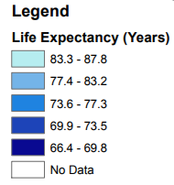
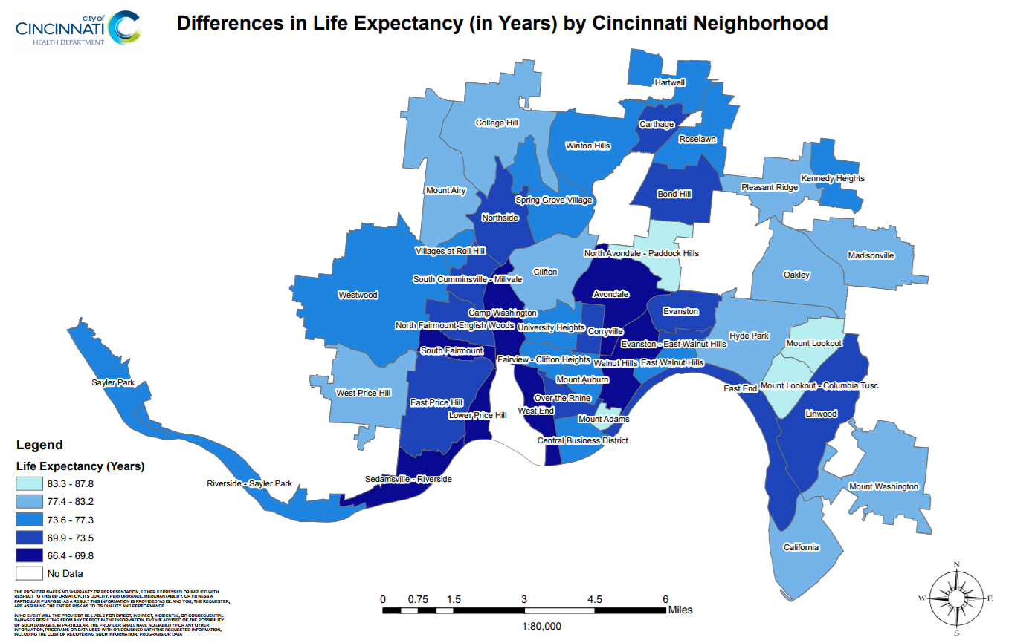
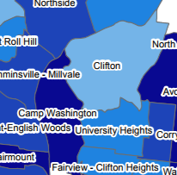
Figure 6: Life Expectancies
http://www.cincinnati-oh.gov/health/assets/File/FinalLifeExpect.pdf
Notes:
All of this is interesting, but how does it relate to our research?
The life expectancy in years by Cincinnati neighborhood varies greatly...
Camp Washington approximately 68 years
Clifton approximately 80 years
To better understand air pollution’s role in a neighborhood such as Camp Washington, our study focuses on the collecting of air and noise pollution data at the Near Roadway site (NR site) and comparing that with data from the Taft site (located in Clifton), and in various microenvironments near each site.

Slide 10
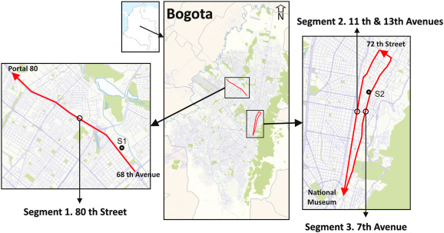
Background Literature Review
Bogota, Columbia - modes of transportation, physical activity, transportation time, and speed.
Betancourt et al. (2017), including Dr. Siv!
Figure 7: Bogota Routes
Notes:
We want to highlight 2 studies from our literature that have significant associations with our research. The first study by Betancourt et al looked at walking, cycling, riding a bus, car, taxi, or motorcycle along three routes in Bogota, Columbia. They found that buses had the highest exposure to BC and PM, while walkers had the highest dose (due to longer exposure times and increased breathing rates).

Slide 11
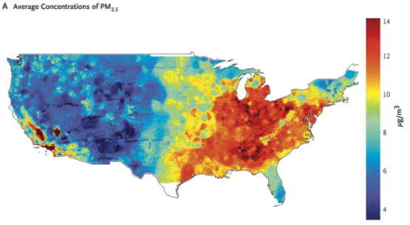
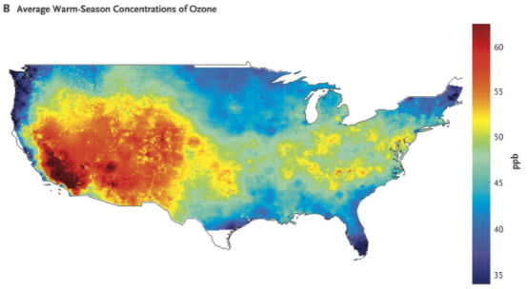
Background Literature Review
Medicare cohort study - stronger association between PM_{2.5} and mortality.
Di et al., 2017
Figure 8: Concentrations of PM_{2.5}
Figure 9: Concentrations of Ozone
Notes:
This study from June in The New England Journal of Medicine looked at about 61 million Medicare beneficiaries from 2000 to 2012. There was significant evidence of adverse effects related to exposure to PM2.5 and ozone at concentrations below current national standards. This effect was most pronounced among self-identified racial minorities and people with low income. In fact, black, asian, and hispanic men had higher risk of death (up to 3 times) from PM_{2.5} and Ozone.

Slide 12
Goals
Since pollution varies spatially, we want to monitor various areas through the use of lower-cost, portable monitors to gather more data on air pollutant (PM_{2.5} and BC) and sound levels.
The overarching goal of this research study is to understand air pollutant concentrations (PM_{2.5} and BC) in different microenvironments as well as to evaluate the lower-cost, portable monitors.

Slide 13
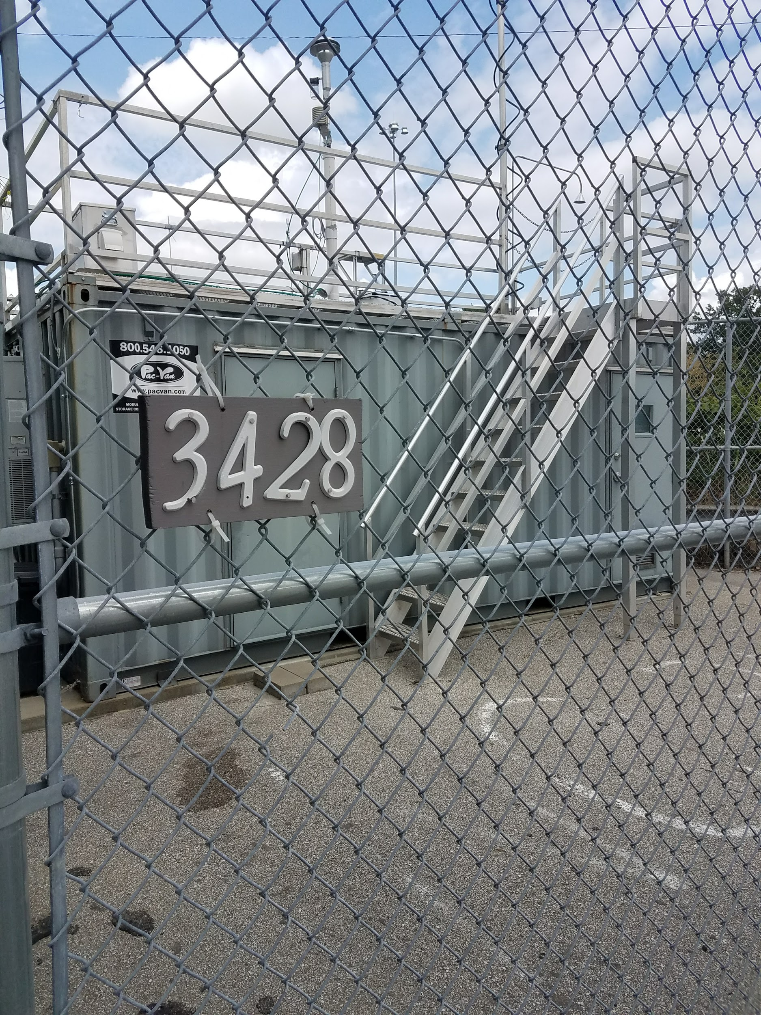
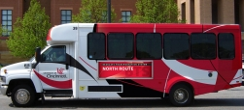
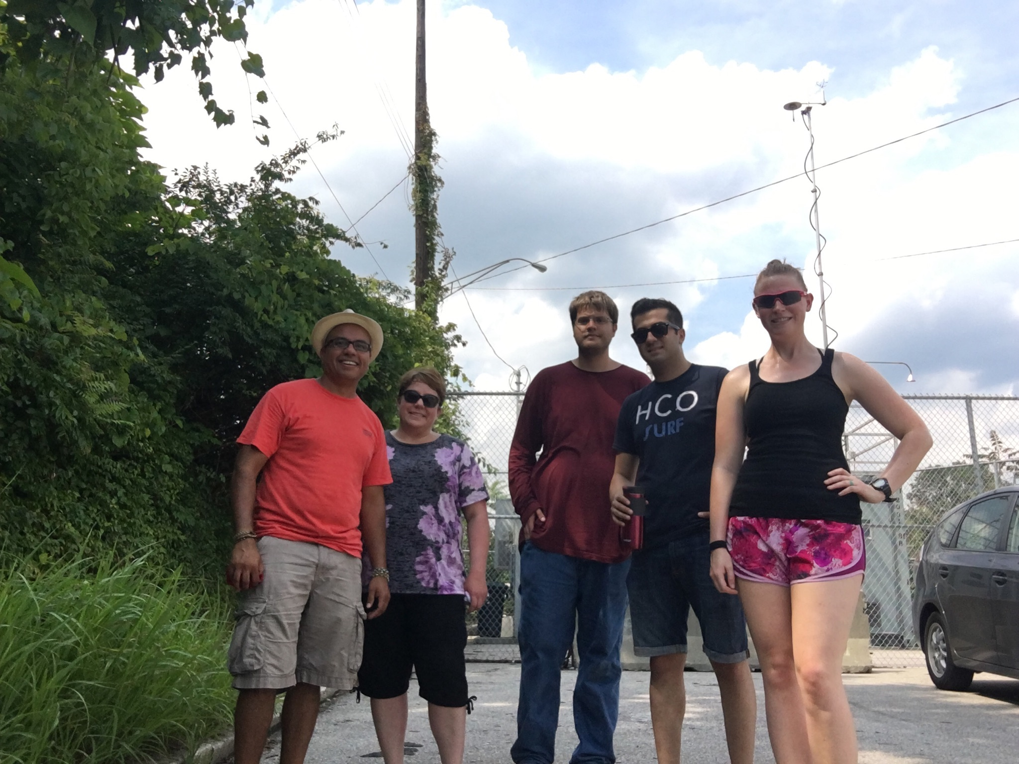
Objectives
https://www.uc.edu/af/facilities/services/shuttle.html
Collect and understand spatiotemporal variability of PM_{2.5} and BC from microenvironments:
Near roadway site
In vehicle commutes
Walking
Shuttle bus
Understand environmental data analysis
Compare low-cost to high-cost sensors
Figure 10: Campus Shuttle
Figure 11:
Camp Washington Walk
Figure 12: Near Roadway Site
Notes:
https://photos.google.com/share/AF1QipOEPyKIEz_0_-9mBKwAxdfWqPwxOu8VFUtYZ2rzkApHRDhDO_DetMLCYnhB9WyICQ?key=SllZYnNodUdZSXBJTnpodUZ2dWMybWMyaG50ejJ3

Slide 14
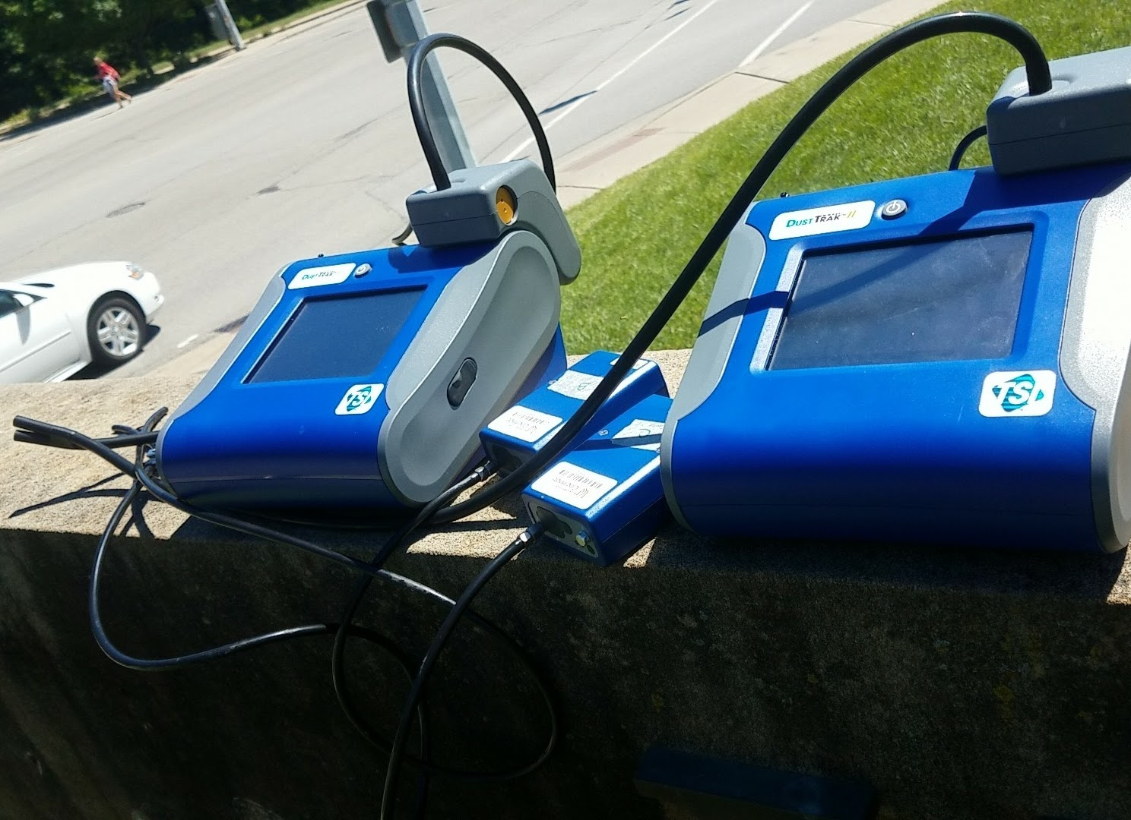
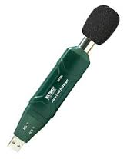
Research Methods
Instruments Used
Operation of DustTrak to collect PM_{2.5} and microAeth Model AE51 to collect BC
Operation of Extech USB Sound Level Datalogger
Collection of GPS data
GeoTracker
Mobile Logger
Figure 13: DustTrak and AE51 Monitors
http://www.extech.com/display/?id=14225
Figure 14: Extech USB Sound Level Datalogger

Slide 15
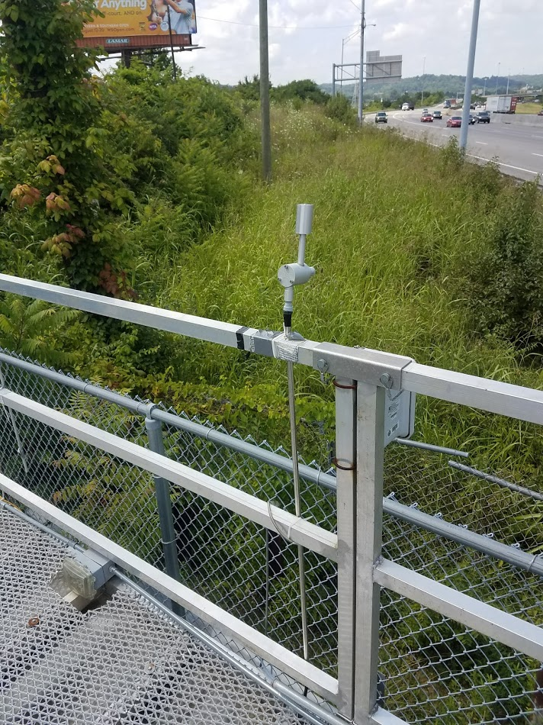
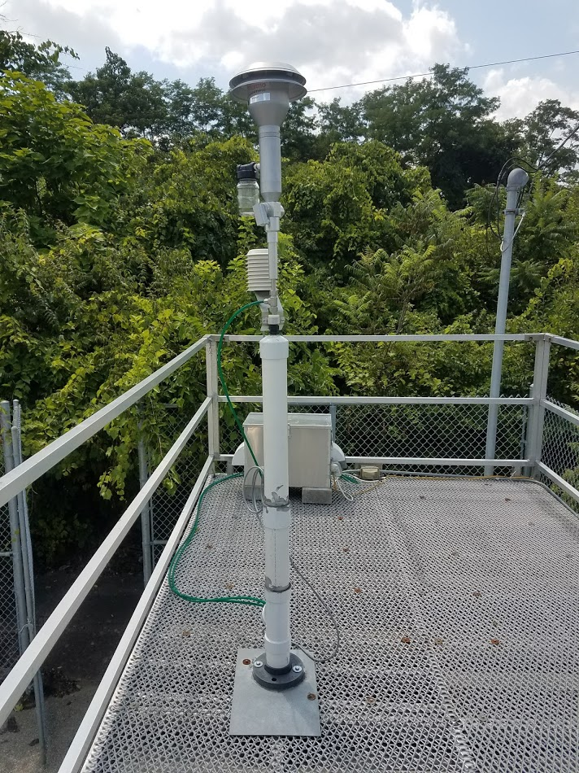
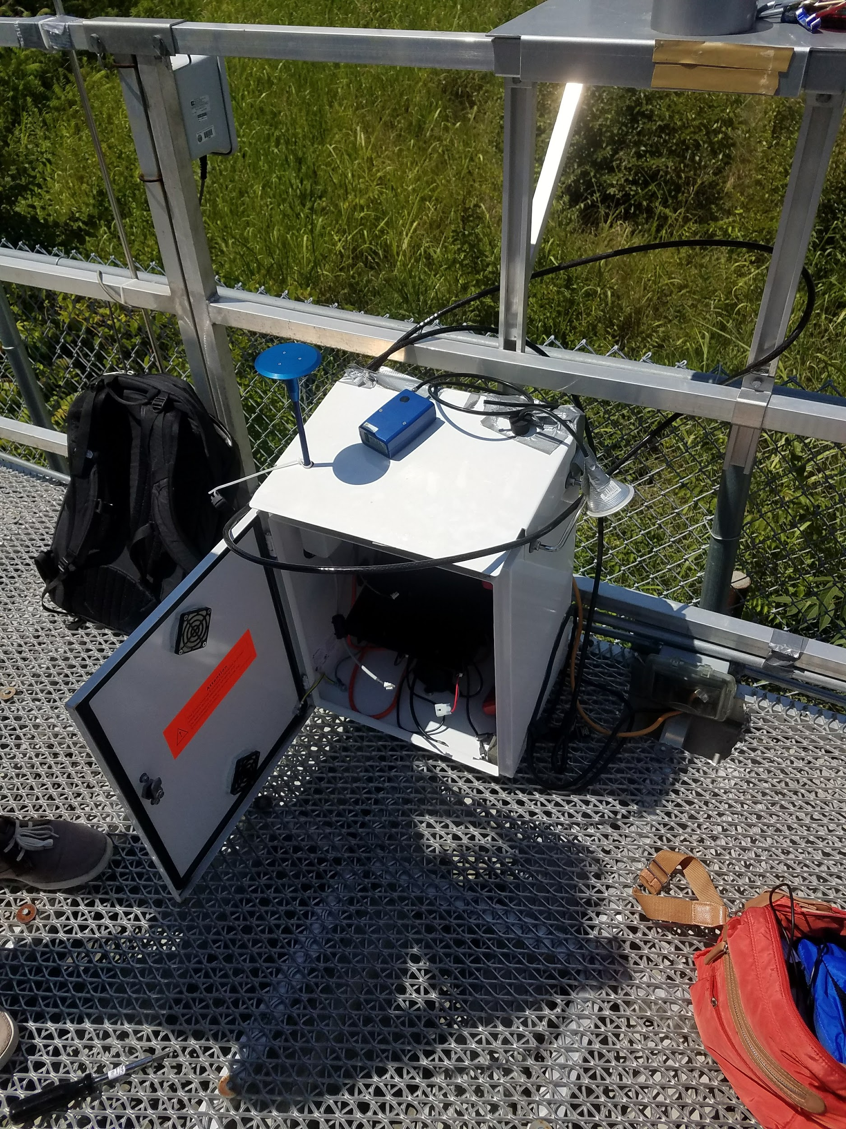
Compare Low-Cost with High-Cost Sensors
DustTrak vs. Thermo SHARP 5030i
AE-51 vs. SWOAQA Aethalometer
Figure 17: Aethalometer
Figure 15: DustTrak and AE-51
Figure 16: SHARP 5030i

Slide 16
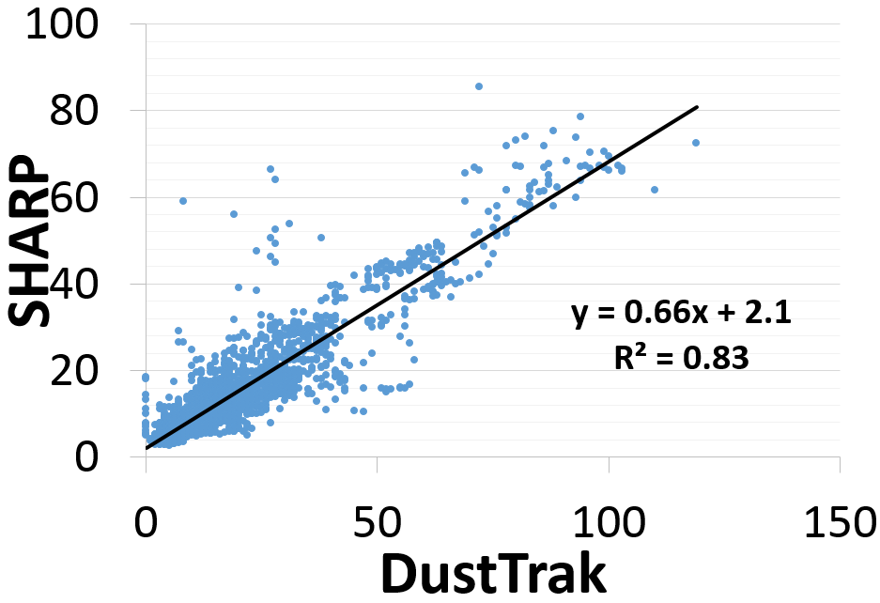
Research Results: SHARP vs. DustTrak
Figure 18: SHARP vs. DustTrak

Slide 17
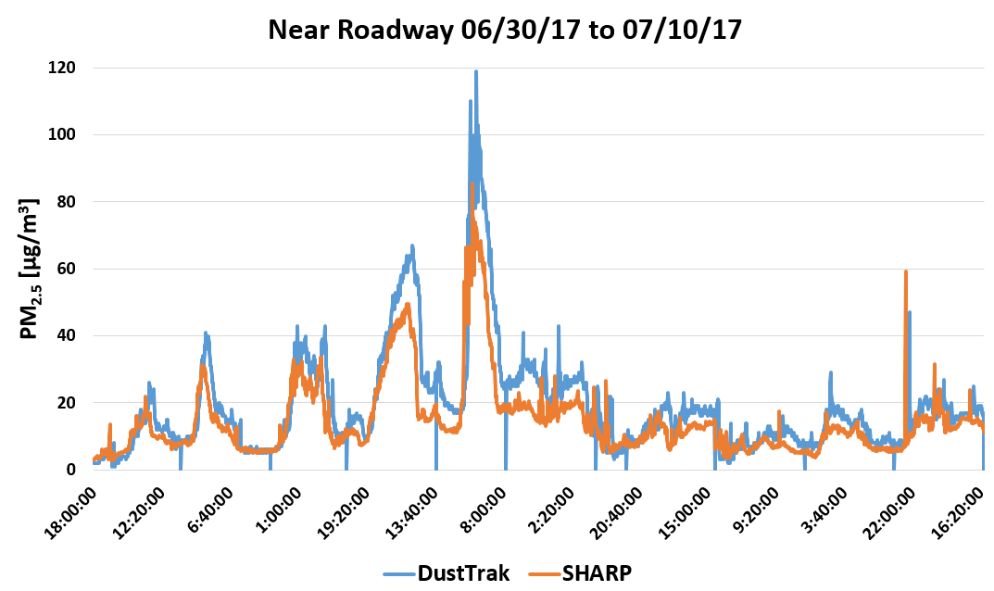
July 4th fireworks
Figure 19: PM_{2.5} over time

Slide 18
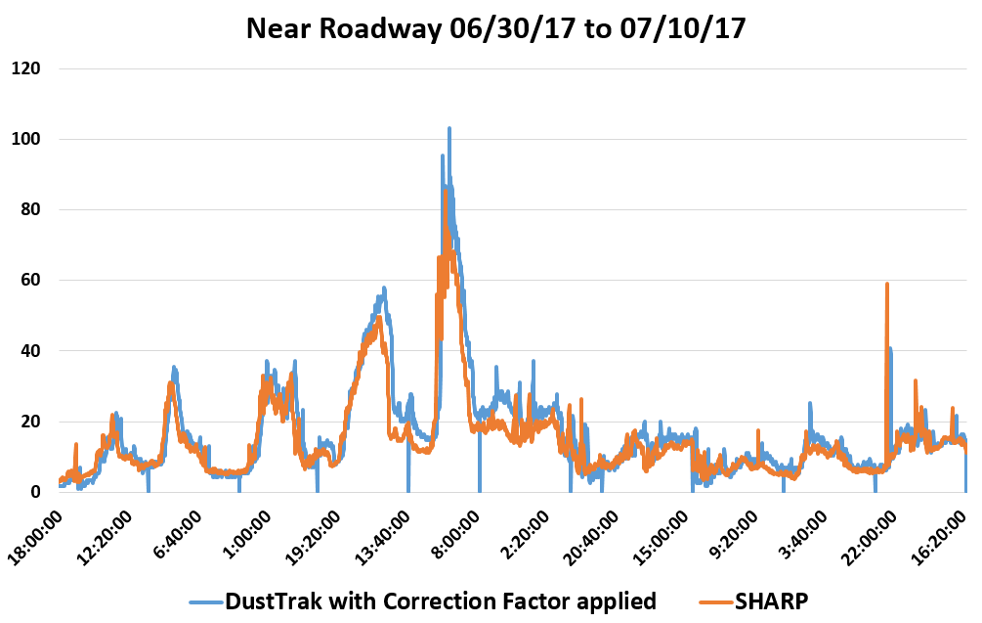
July 4th fireworks
Figure 20: PM_{2.5} with
Correction Factor

Slide 19
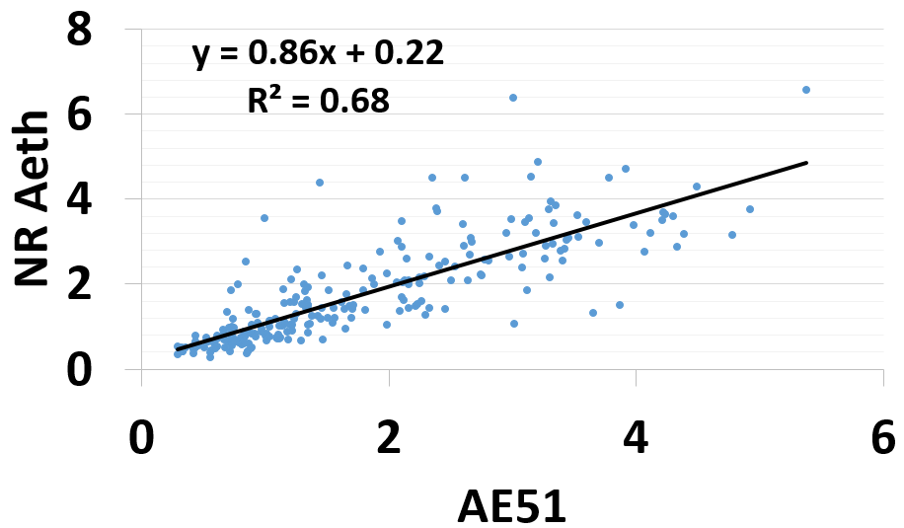
Research Results: Aethalometer vs. AE-51
Figure 21: Aethalometer vs. AE-51

Slide 20
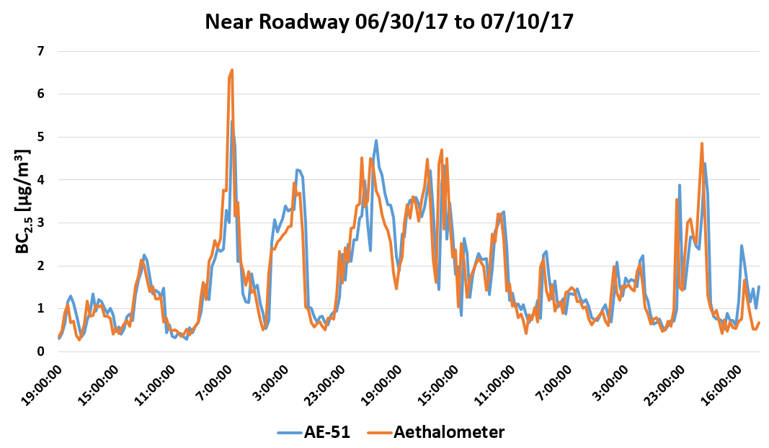
Figure 22: BC over time

Slide 21
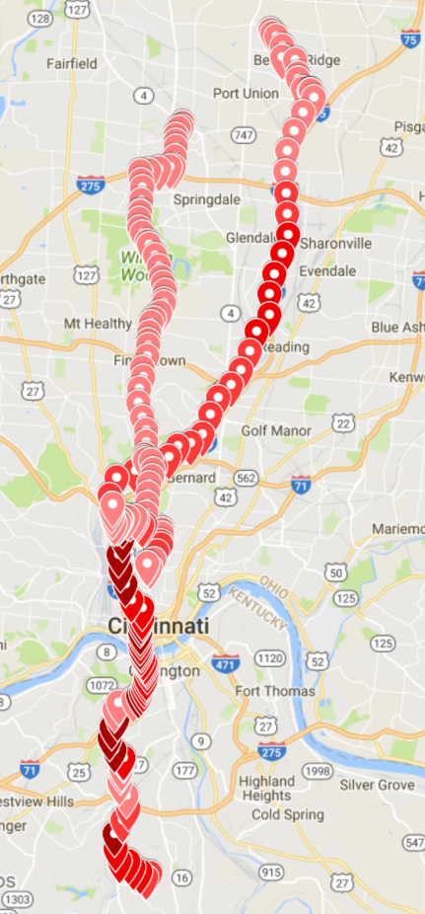
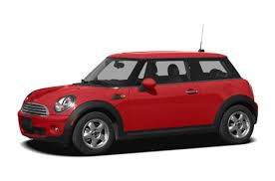
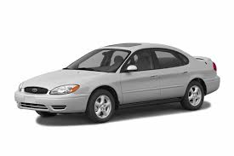
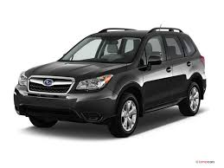
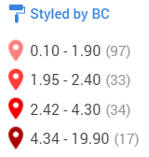
Commute Studies
Weekday morning & afternoon rush hour 06/62/17-07/14/17
Fairfield, Blue Ash, Colerain, West Chester, Kentucky
Car make/year, windows up/down, AC on/off
Figure 24: Mini Cooper
Figure 25: Ford Taurus
Figure 23: GPS and BC Commute Data During AM Rush Hour 07/05/17
Figure 26: Subaru Forester
https://www.cars.com/research/mini-cooper-2007/
http://blog.caranddriver.com/subaru-forester-updated-for-japan-likely-for-our-market-for-2017/
http://www.autoblog.com/buy/2004-Ford-Taurus/

Slide 22
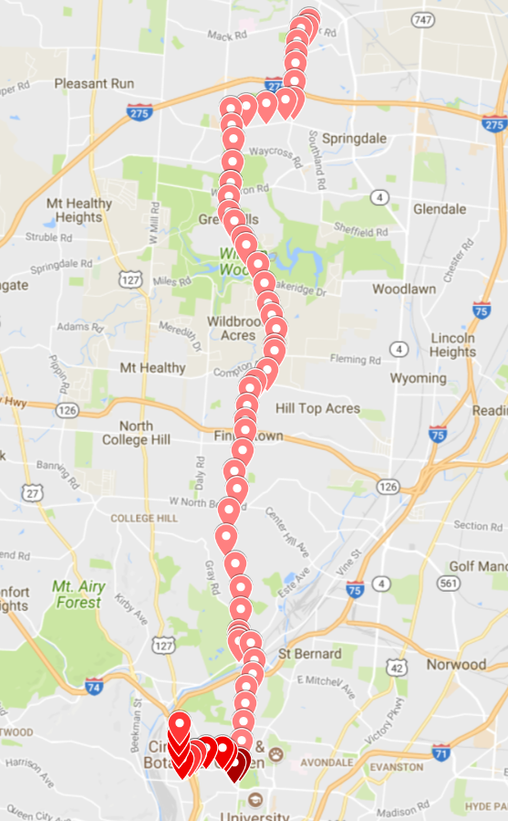
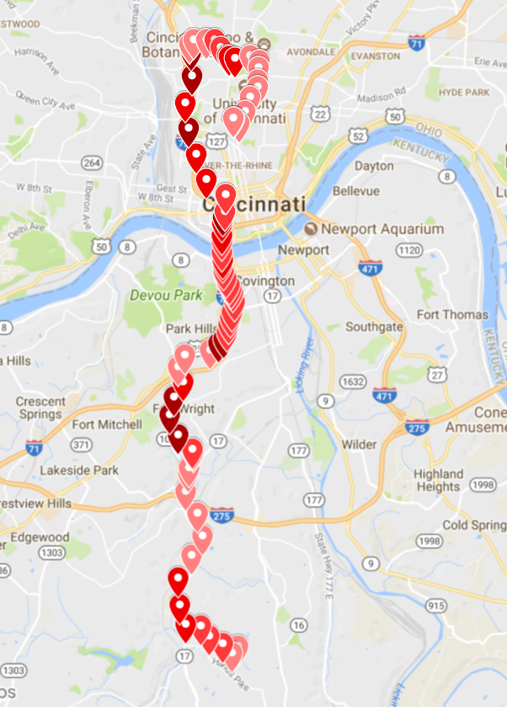
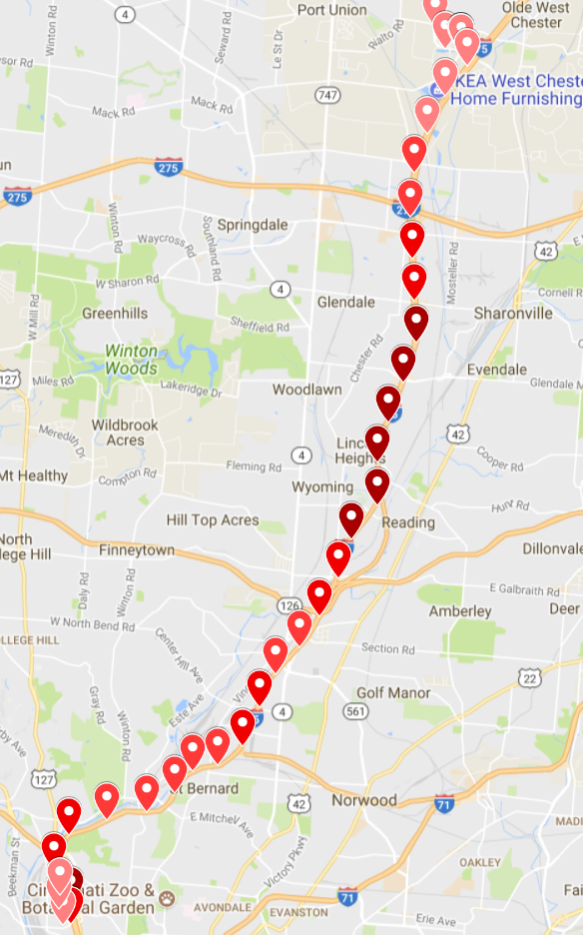
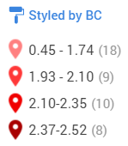
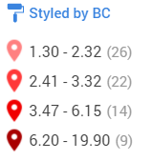
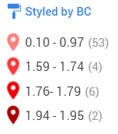
Research Results: Commute Studies
Figure 27: Kat’s Commute
Figure 28: Dexter’s Commute
Figure 29: Molly’s Commute
Notes:
Kat--2015 Subaru Forester windows up and AC on; backroads
Dexter-- 2004 Taurus windows down no AC; highway (I-75)
Molly--2004 Mini Cooper windows up and AC on; highway (I-75)

Slide 23
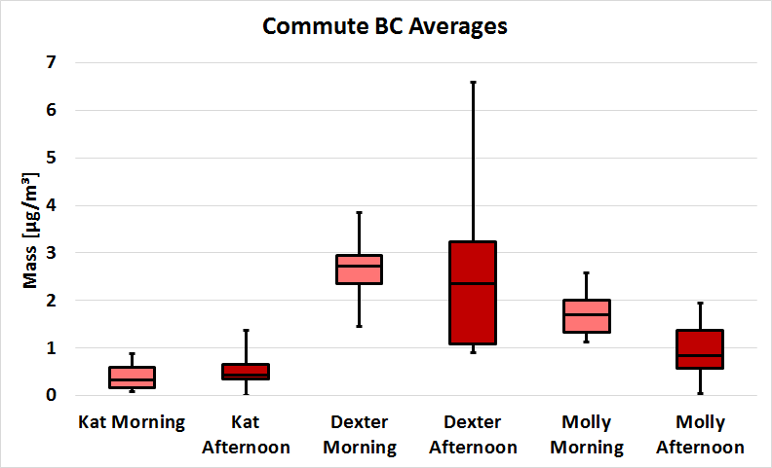
Figure 30: Commute BC Averages

Slide 24
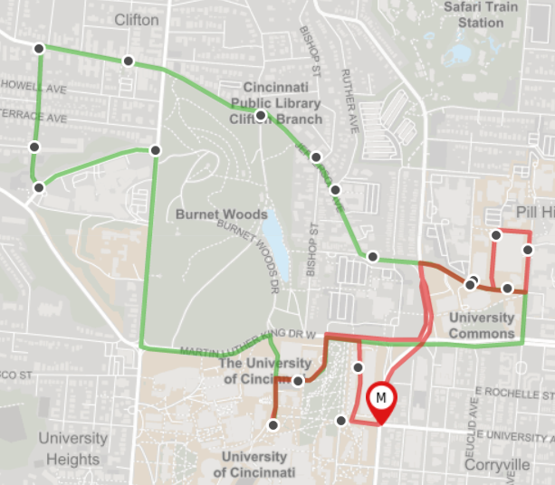
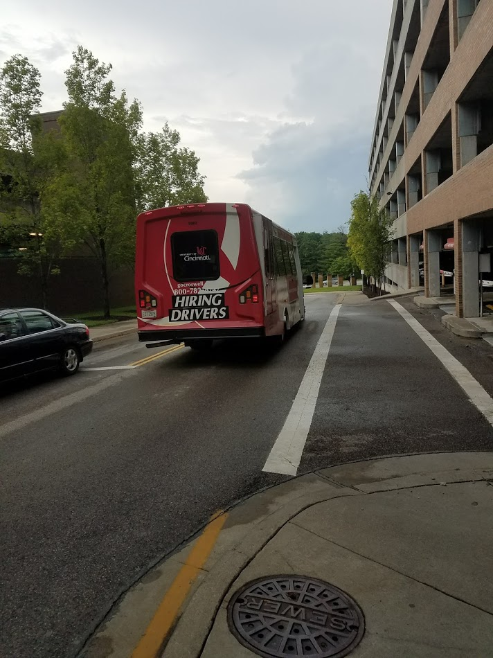
Shuttle
Main St./ Eden Ave. Garage Route
North Route
Figure 32: Shuttle Bus Routes
Figure 31: Shuttle Bus

Slide 25
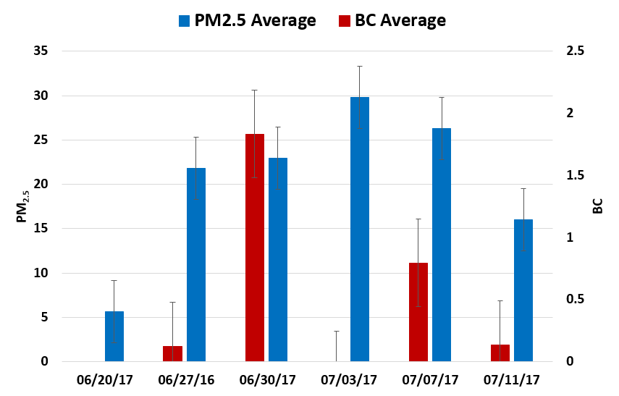
Research Results: Shuttle route
Figure 33: Shuttle Route PM_{2.5} and BC

Slide 26
Walking Studies
UC Shuttle Bus Route
Camp Washington
CW#1: 07/12/17
2 separate walks
CW#1K: PM_{2.5} and BC (90 secs)
CW#1M: PM_{2.5}, BC, and sound (30 secs)
CW#2: 07/14/17
PM_{2.5}
CW#3: 07/17/17
PM_{2.5} and sound
Figure 34: Walking

Slide 27
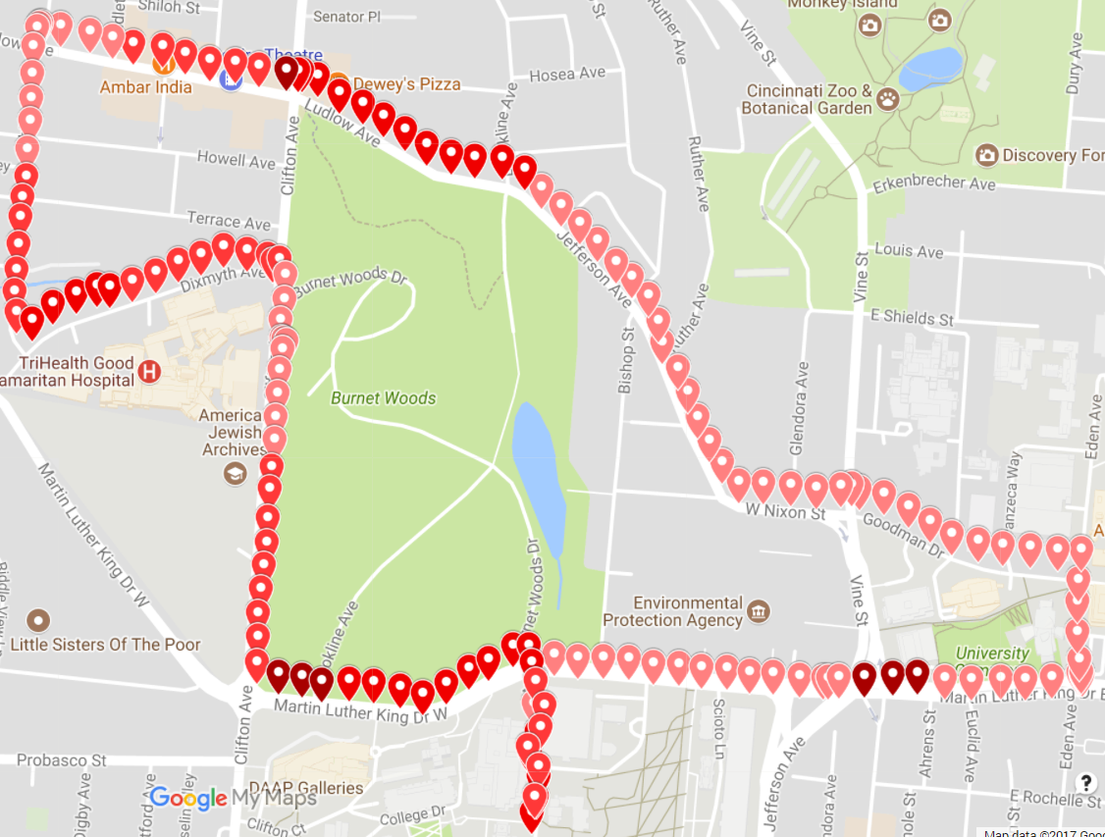
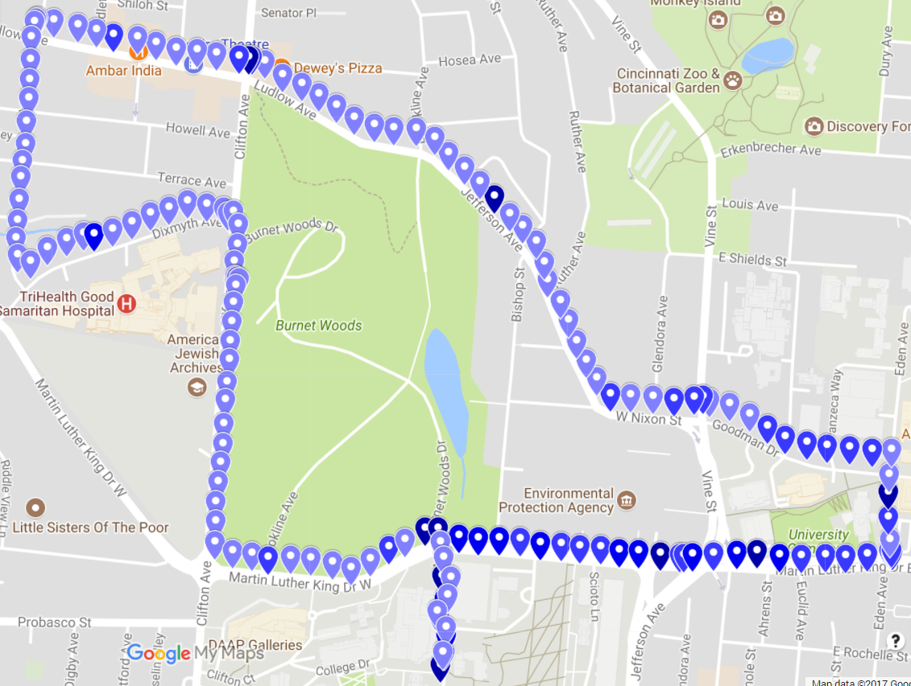
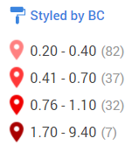
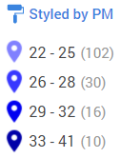
Research Results: Walking Studies
(UC Shuttle Walk)
Figure 35: BC [µg/m³]
Figure 36: PM_{2.5} [µg/m³]

Slide 28
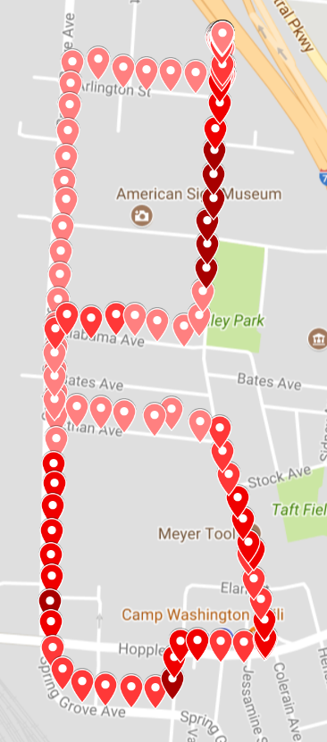
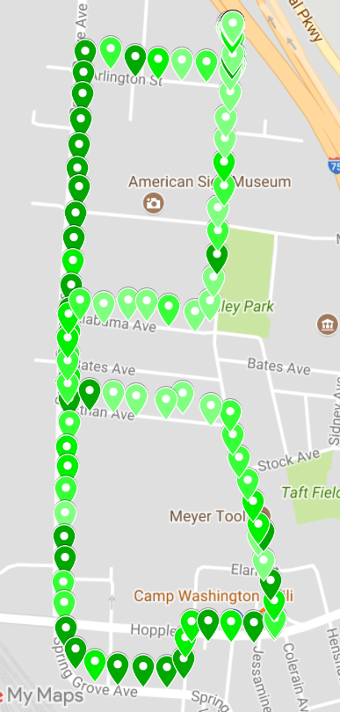
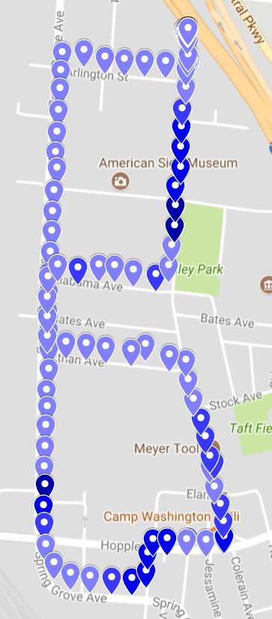
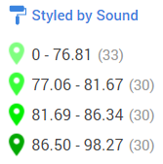
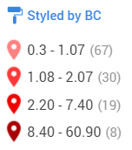
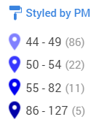
CW#1M
Figure 38: Sound [dB]
Figure 39: PM_{2.5} [µg/m³]
Figure 37: BC [µg/m³]
Notes:
CW#1M
Right next to vehicles on the road--trucks
30 seconds

Slide 29
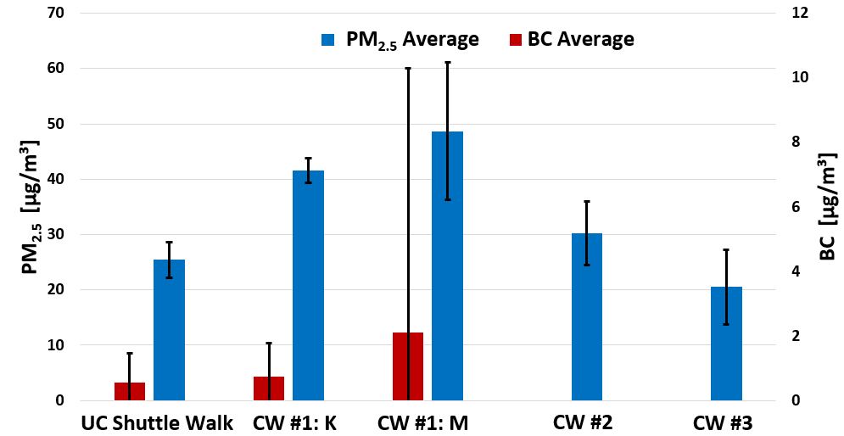
Figure 40: Walking Studies
Walking Studies

Slide 30
BC vs. Sound BC(EC)/PM_{2.5} Ratio
NR Site vs. Taft Site
BC & sound data at the NR site
07/14/17 at 15:25:00 to 07/15/17 at 17:45:00
07/15/17 at 21:10:00 to 07/16/17 at 13:45:00
07/16/17 at 16:00:00 to 07/17/17 at 13:05:00
BC: five minute collections
Sound: every second and averaged to five minutes and one hour
Figure 41: NR Site Setup

Slide 31
Research Results: BC vs. Sound
Figure 42: Five Minute Averages

Slide 32
Research Results: BC vs. Sound
Figure 43: One Hour Averages

Slide 33
Research Methods and Results: BC(EC)/PM_{2.5} Ratio
Calculated BC(EC)/PM_{2.5} ratio from data collected over time
Averaged that data
Taft site: ~5.3%
NR Site: ~11.9%
Figure 44: Calculations in Excel

Slide 34
Research Conclusions
Compare DustTrak and AE-51 to Regulatory Instruments
Good correlation between instruments
Lower cost, portable monitors are a good alternative to higher cost monitors
Concentrations at NR site greatly impacted by precipitation, wind speed and direction
Shuttle
Large amounts of variability
Moderate concentrations of PM_{2.5} and BC
Black Carbon vs. Sound
Mild correlation between hourly averages of BC and sound
Figure 45: PM_{2.5} Wind Rose Chart (µg/m³) at Near Roadway Site 06/30/17 to 07/12/17

Slide 35
Research Conclusions
Figure 46: Topographic Terrain Map
Commute studies
Traffic-heavy areas/highway
Windows down
Exposure to high concentrations of air pollutants
Walking studies
BC concentrations drop further from a source
Different days at different times
Weather varies
Terrain/altitudes
Notes:
Camp Washington 495-506 feet
UC sits at about 804-828 feet

Slide 36
Research Conclusions
Figure 47: NR Site Proximity to Roadway
BC(EC)/PM_{2.5} Ratio
NR higher BC(EC)/PM_{2.5}
The NR site is 15-25 feet away from a major roadway
Health implications for those who:
live
work
go to school
spend time outdoors

Slide 37
Figure 48: Wordle
Figure 49: Sad Earth
http://cdn.publishyourarticles.net/wp-content/uploads/2015/06/Air-Pollution-Could-Cause-Pregnancy-Complications.jpg
Notes:
Unit Topic: Air Pollution and Air Quality
Essential Question: How can you control emissions of air pollutants from the source?

Slide 38
Figure 50: Global Solution
https://www.wisetechglobal.com/Portals/WTG/Images/Viewpoints%20&%20PR/Think-Globally-Resized.jpg
Notes:
Challenge: Design an air filtration device that can filter indoor air pollutants (specifically particulate matter).

Slide 39
Decibel Scale
Figure 51: Decibel Scale

Slide 40
Figure 53: Challenge Materials
Figure 52: Noise Pollution and Sound
Figure 54: Sound Amplifier

Slide 41
Questions??

Slide 42
Link to video:
https://youtu.be/oRBcm4mReao

